Slide 1


Green University of Bangladesh
Department of Computer Science and Engineering
Semester: Spring 2024, BSc in CSE(DAY)
Section:223-D6
E-Commerce Website: Digital Mart
Submitted to, Mr. Montaser Abdul Quader Lecturer
Dept. of CSE Green University of Bangladesh
Submitted by, Md Jubayerul Hasan Mahin (213902127)
Tasmia Noor Tama (223902001)
Dept. of CSE Green University of Bangladesh

Slide 2

Contents
Introdunction
Project Scope
System Architecture
Design and User Interface
Technologies and Tools
Security Features
Future Enhancements
Conclusion

Slide 3


Introduction
Brief description of the project:
Purpose: To create a dynamic and user-friendly e-commerce platform.
Goal: Streamline online shopping and enhance user experience for both shoppers and administrators.
Target Audience:
General shoppers for browsing and purchasing.
Admins for managing inventory and user activities.

Slide 4
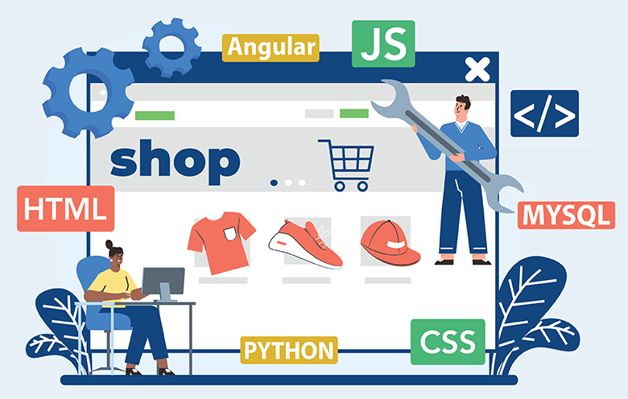
Project Scope
Functional Features:
User Registration and Authentication
Product Browsing, Sorting, and Filtering
Shopping Cart and Checkout Process
Payment Gateway Integration (e.g., PayPal, Stripe)
Admin Dashboard for Product Management
Customer Profile and Order History

Slide 5

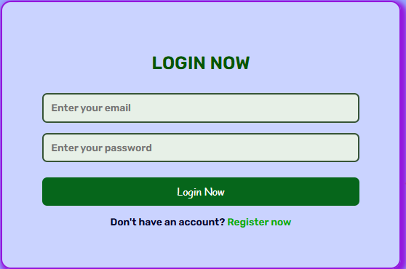

Key Functionalities
User Features:
User Registration and Login.
Product Search, Filtering, and Sorting.
Cart and Wishlist for easy purchasing decisions.
Admin Features:
Add, Edit, or Remove Products.
Manage User Accounts and Orders.
View sales reports and analytics.
Database Integration:
Secure storage for user information, product data, and
order records

Slide 6
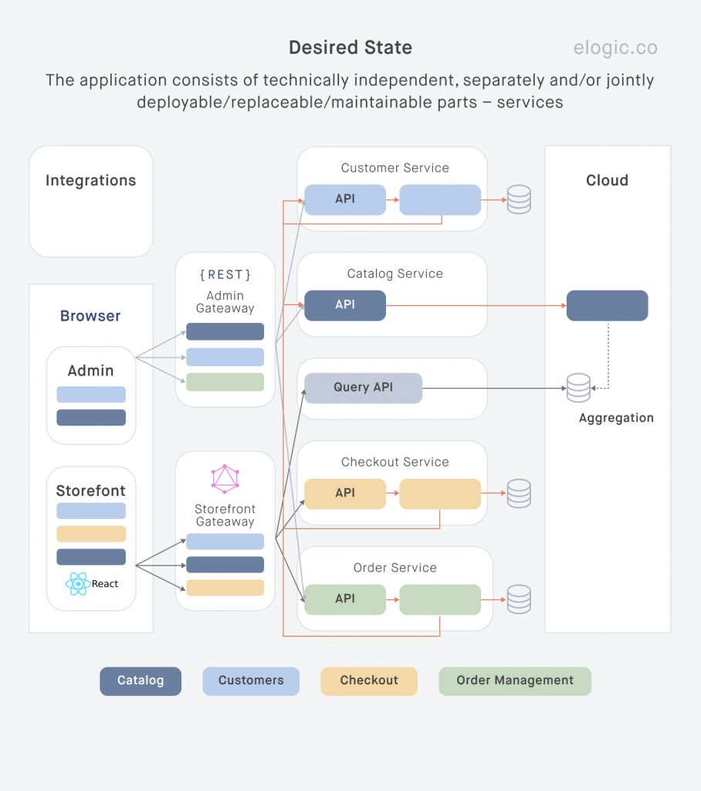
System Architecture
Frontend:
Built with HTML, CSS, JavaScript (React/Angular/Vue.js) for a dynamic, responsive user interface.
Backend:
Node.js/PHP/Python-based server to handle business logic, API endpoints, and user requests.
Database:
Relational (MySQL/PostgreSQL) or NoSQL (MongoDB) database to store product details, user accounts, and transactions.
Cloud Hosting:
Deployed on AWS/Google Cloud for scalability, high availability, and reliability.
Payment Gateway Integration:
API integration with payment processors like PayPal, Stripe, or local alternatives.

Slide 7

Design and User Interface
User-Centric Design:
A clean and intuitive design that ensures an easy shopping experience.
Consistent branding, visually appealing product displays, and simple navigation.
Responsive Layout:
The mobile-first design ensures accessibility and optimal user experience across devices (desktop, tablet, smartphone).

Slide 8

Technologies and Tools
Frontend Technologies:
HTML5, CSS3, JavaScript (React.js/Angular/Vue.js)
Backend Technologies:
Node.js (Express.js), PHP (Laravel), or Python (Django/Flask)
Database:
MySQL/PostgreSQL (Relational) or MongoDB (NoSQL)
Version Control:
Git, GitHub for code collaboration and version tracking.
Hosting & Cloud Infrastructure:
AWS, Google Cloud for hosting and data storage.

Slide 9
Security Features
SSL Encryption:
All data exchanged between the user and the server is encrypted for security.
Authentication and Authorization:
A secure user login system with password hashing and multi-factor authentication (MFA) is used.
Payment Security:
Use tokenization and secure third-party payment gateways (e.g., Stripe/PayPal).
Data Protection:
Compliance with GDPR for handling user data and ensuring privacy.

Slide 10

Future Enhancements
User Experience Enhancements:
Personalized recommendations based on user behavior.
AI-based chatbot for customer support.
Additional Features:
Social media login integration (e.g., Facebook, Google).
Subscription-based product delivery model.
Performance Optimizations:
Implementing caching techniques to speed up product pages and checkout processes.

Slide 11

Technical Implementation
Frontend:
Built with HTML, CSS, and JavaScript for a responsive and interactive user interface.
Backend:
Powered by PHP for server-side processing.
Database:
MySQL for structured data management.
Reusable Components:
Includes modular header.php and footer.php for consistent layout.
Interactivity:
JavaScript for dynamic UI elements like cart updates and filters.

Slide 12
Conclusion
Summary:
The e-commerce website provides a feature-rich, user-friendly platform for online shopping, with a secure and scalable backend infrastructure.
Achievements:
Successfully implemented key functionalities such as user registration, product catalog, shopping cart, and payment integration.
Key Learnings:
Gained valuable experience in full-stack development, cloud hosting, and security best practices.

